Slide 1


Digital Control in Power Electronics
杭丽君
ljhang@hdu.edu.cn
2018/7/15
可再生能源及微型电力网技术实验室
Regeneration energy and microgrid Technology Lab(REMT)

Slide 2
课 程 内 容
Introduction: Digital Control Application to Power Electronic Circuits
The Test Case: a Single-Phase Voltage Source Inverter
Digital Current Mode Control
Extension to Three-Phase Inverters
External Control Loops

Slide 3
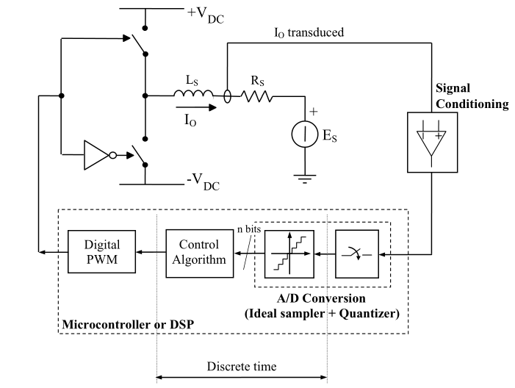
3.1 REQUIREMENTS OF THE DIGITAL CONTROLLER
Typical organization of a digital current controller

Slide 4
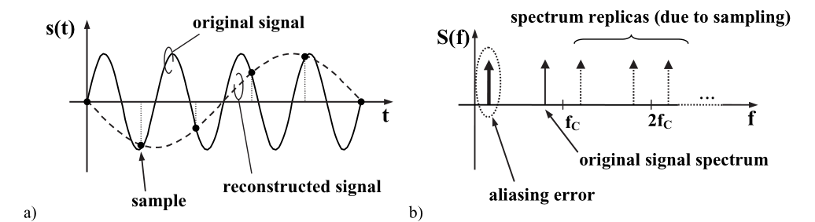
3.1.1 Signal Conditioning and Sampling
(a) Effect of a too low sampling frequency on the reconstructed signal (aliasing).
(b) Interpretation of the aliasing effect of (a) in the frequency domain. Note how a low-frequency spectrum component is generated because of aliasing.
混叠的意思,即对模拟信号进行抽样,当抽样频率小于信号最大频率2倍时,不满足奈奎斯特采样定律,信号在频域会产生混叠效应。

Slide 5
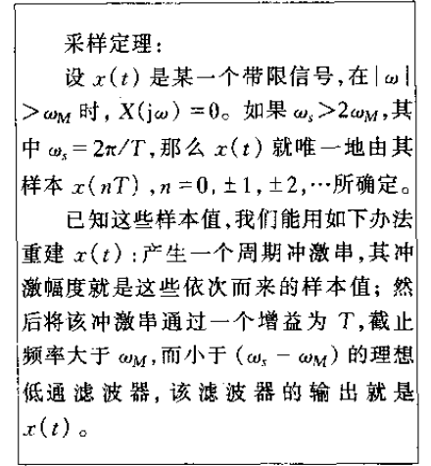
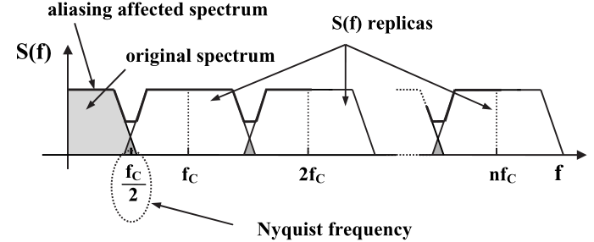

3.1.1 Signal Conditioning and Sampling
A more general situation: a distorted, aliasing-affected, spectrum is reconstructed because of the partial overlap of spectrum replicas.

Slide 6
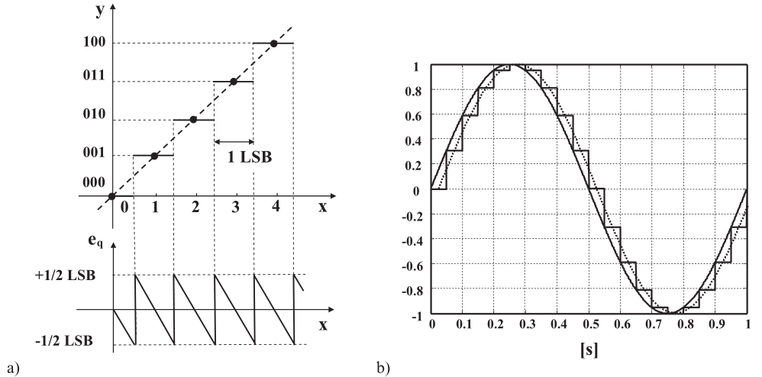
3.1.1 Signal Conditioning and Sampling
(a) Uniform quantizer transcharacteristic and quantization error. (b) Sample and hold delay effect: compare the input signal (continuous line) and the reconstructed output signal, i.e., the fundamental harmonic component of the sampled signal (dotted line).

Slide 7
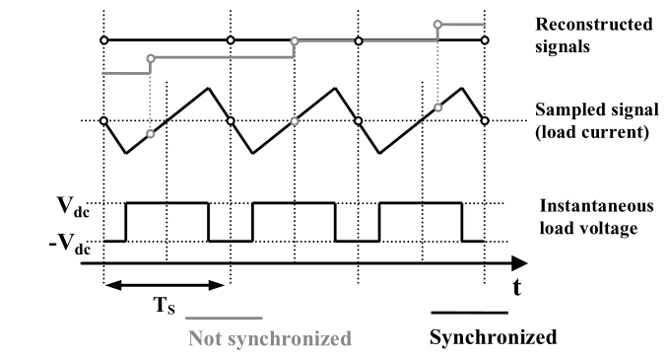
3.1.2 Synchronization Between Sampling and PWM
Example of synchronized sampling and switching processes. In case the sampling takes place always at the beginning (or in the middle) of the modulation period, the average current value is automatically obtained. If the sampling frequency is lower than the switching one, an aliased, low-frequency component appears on the reconstructed signal.

Slide 8
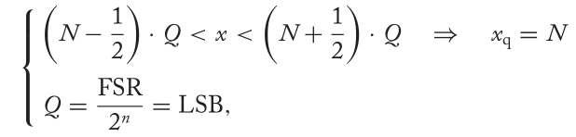


3.1.3 Quantization Noise and Arithmetic Noise
Quantization of variables and finite arithmetic precision are two among the most critical issues in digital control.

Slide 9
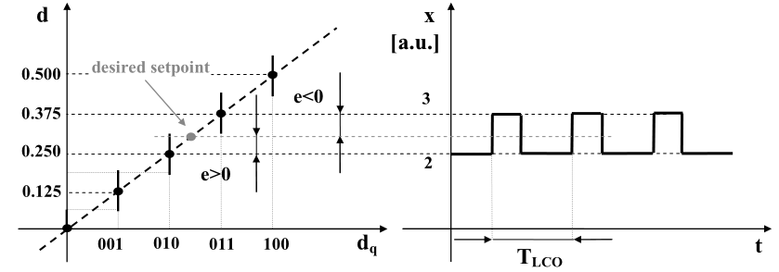
3.1.3 Quantization Noise and Arithmetic Noise
Example of limit cycle occurrence. The desired set-point for the output control variable d is not one of the possible output values. Consequently, the system oscillates, with period T LCO , between the two closest outputs. Here we assume that the system includes at least one integral action in the transfer function from the input to the output.

Slide 10
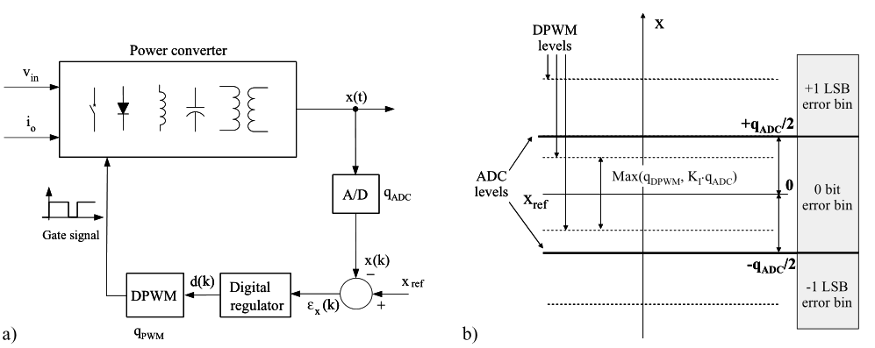
3.1.3 Quantization Noise and Arithmetic Noise
(a) Digitally controlled power converter with ADC and DPWM quantization;
(b) quan-tization of state variable x(t) and effects of DPWM quantization.

Slide 11
3.2 BASIC DIGITAL CURRENT CONTROL IMPLEMENTATIONS
Different control algorithms and the related design criteria,with the intention of high lighting the merits and the limitations of each solution.
We will focus our attention on the performance allowed by the different solutions and on the impact of the digital controller implementation on the dynamic response of the converter, considering, in particular, figures of merit like the response delay to step changes in the current reference, or the residual tracking error in the presence of sinusoidal reference current signals.

Slide 12
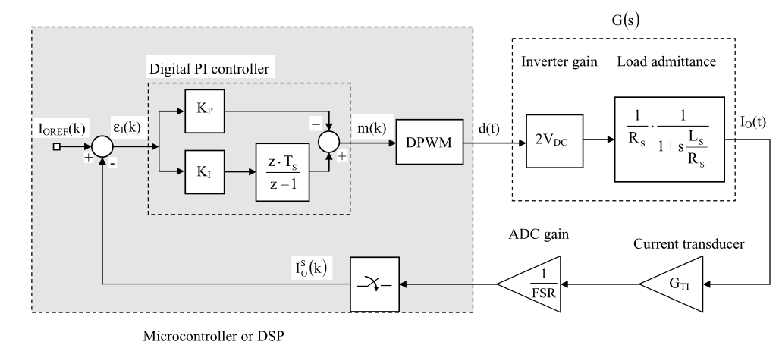
3.2.1 The Proportional Integral Controller: Overview
Full scale range
Block diagram of the digital current control loop with PI regulator.

Slide 13
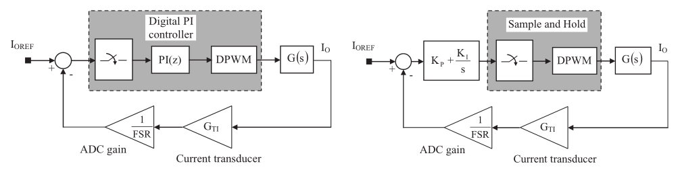
3.2.2 Simplified Dynamic Model of Delays
Procedure to define the continuous time equivalent of the digital current control loop.

Slide 14
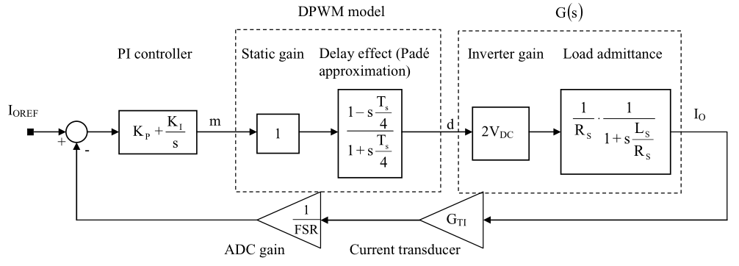
3.2.2 Simplified Dynamic Model of Delays
Block diagram of the continuous time equivalent of the digital current control loop.

Slide 15
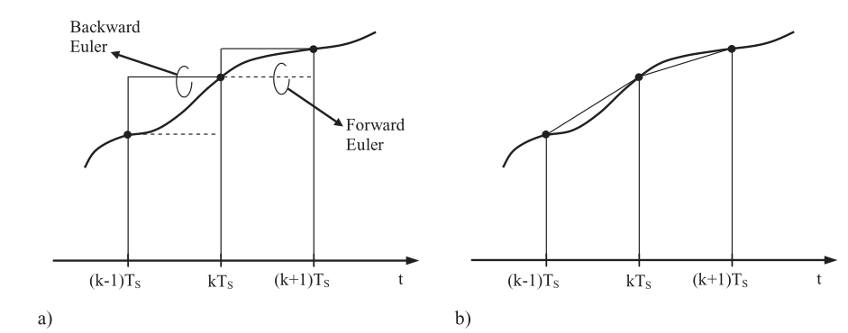
3.2.3 The Proportional Integral Controller: Discretization Strategies
(a) Euler integration method (forward and backward). (b) Trapezoidal integration method.

Slide 16
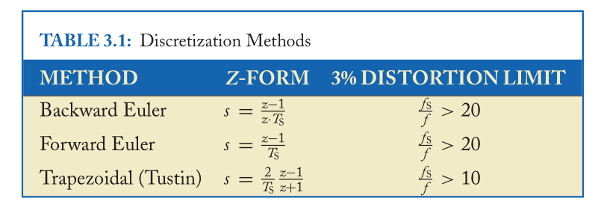
3.2.3 The Proportional Integral Controller: Discretization Strategies
The transformations that are obtained for the two discretization methods, where the two possible versions of the Euler integration method are considered. These are called Z-forms.

Slide 17
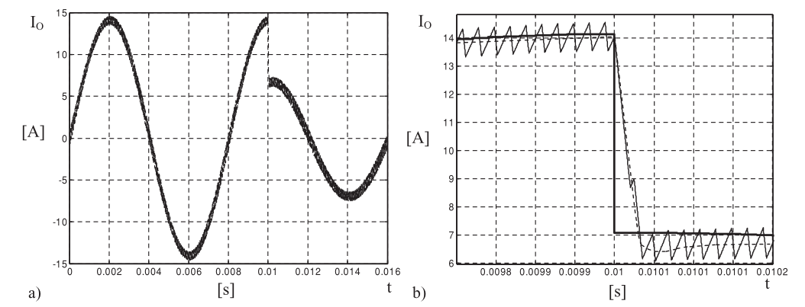
3.2.3 The Proportional Integral Controller: Discretization Strategies
Simulation of the VSI with the controller designed according to the procedure reported in Aside 3. The depicted variable is the VSI output current . (a) Controller response to a step reference amplitude change. (b) Details of the previous figure. It is possible to see that no calculation delay effect has been included in the simulation.

Slide 18
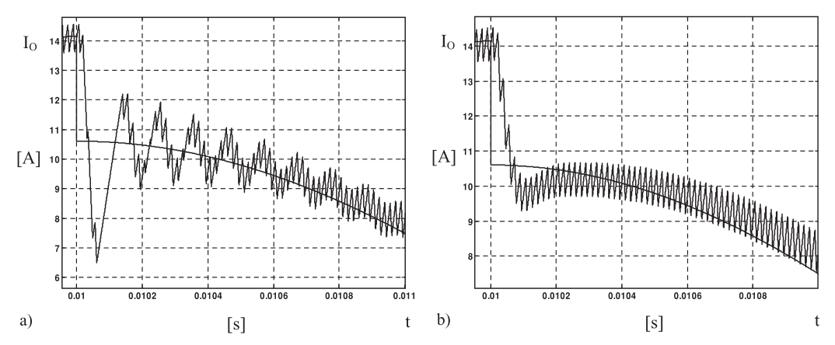
3.2.4 Effects of the Computation Delay
Simulation of the VSI with the digital PI controller including the calculation delay. (a) Details of the controller response to a step reference amplitude change without redesign: undershoot and oscillating response. (b) Details of controller response with redesign: reduced undershoot, reduced speed of response, increase of phase shift.

Slide 19
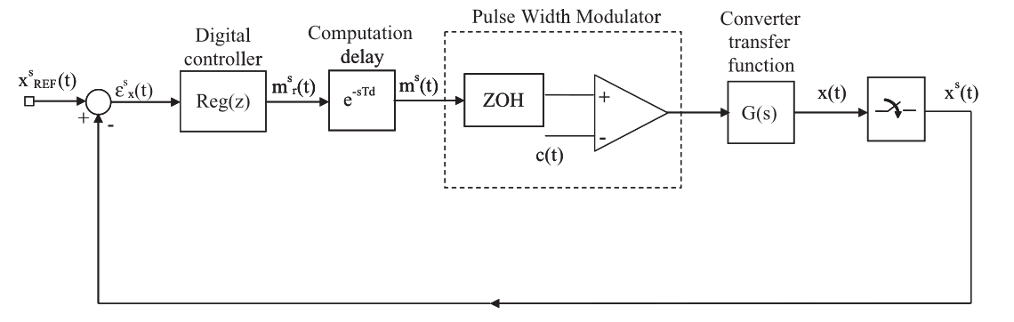
3.2.5 Derivation of a Discrete Time Domain Converter Dynamic Model
Model of the control loop for digitally controlled converters.

Slide 20
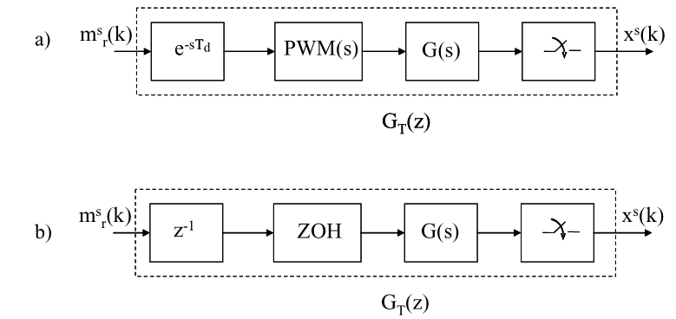
3.2.5 Derivation of a Discrete Time Domain Converter Dynamic Model
Equivalent dynamic model of computation delay, the PWM transfer function, the
converter, and the sampler: (a) general form, (b) simplified representation, where the PWM is approximated as a zero-order hold (ZOH) and the control delay is equal to one modulation period.

Slide 21
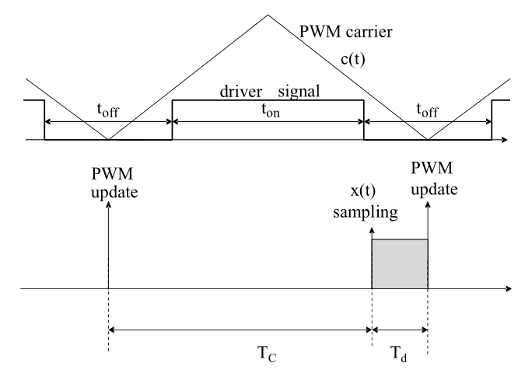
3.2.6 Minimization of the Computation Delay
Sampling of variable x(t) shifted toward the PWM update.

Slide 22
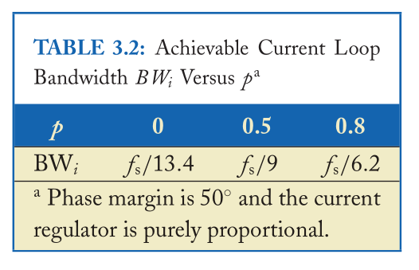
3.2.6 Minimization of the Computation Delay
Model of the control loop for digitally controlled converters.

Slide 23
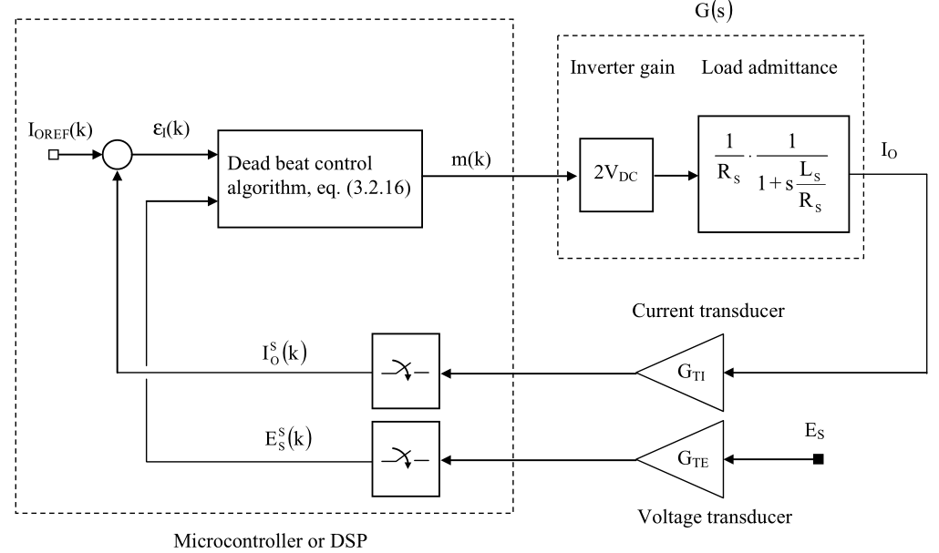
3.2.7 The Predictive Controller
Block diagram of the dead-beat current control loop.

Slide 24
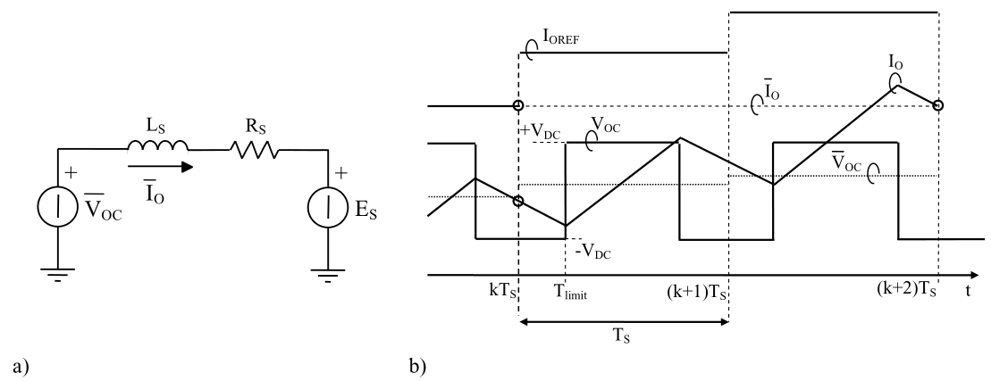
3.2.7.1 Derivation of the Predictive Controller
(a) Average equivalent circuit for the VSI. (b) Average and instantaneous idealized waveforms for the inverter of VSI.

Slide 25
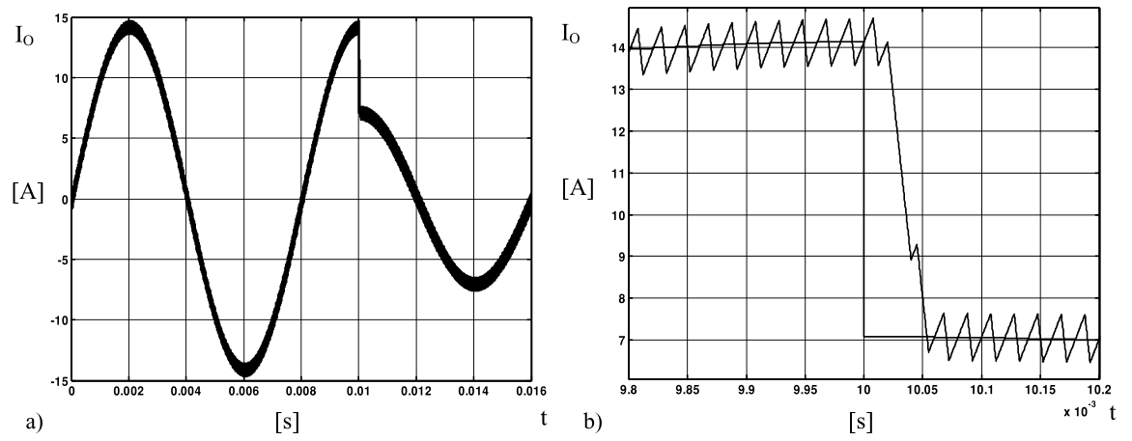
3.2.7.1 Derivation of the Predictive Controller
Simulation of the VSI with the predictive controller. The depicted variable is the VSI output current I_{o}. (a) Controller response to a step reference amplitude change. (b) Details of the previous figure.

Slide 26
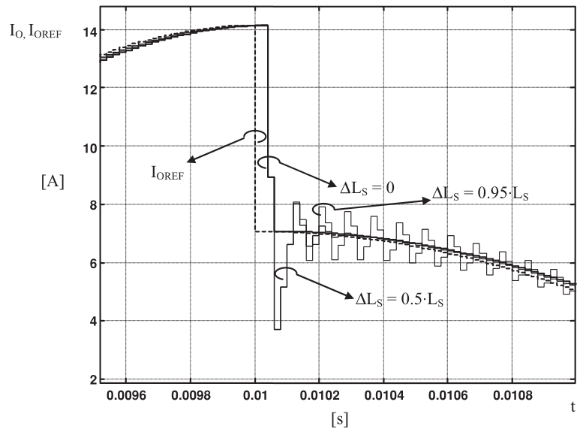
3.2.7.2 Robustness of the Predictive Controller
Simulation of the VSI with the predictive controller and different level of mismatch on parameter L_{s}. The figure shows the response to a step reference change of the sampled VSI output
current I_{o.}

Slide 27
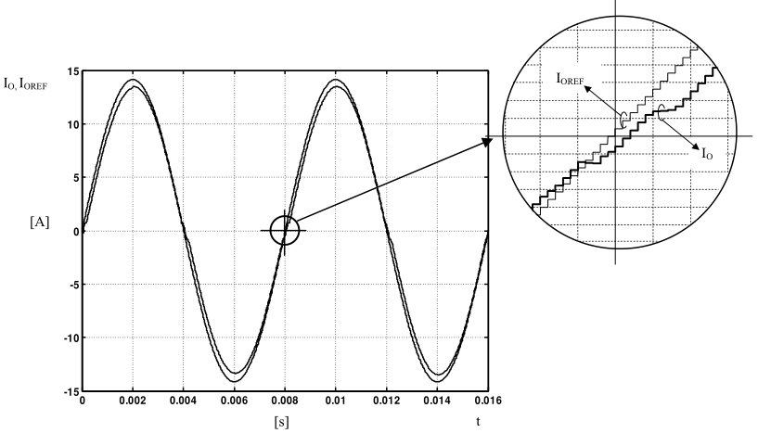
3.2.7.3 Effects of Converter Dead-Times
Simulation of the VSI with the predictive controller and dead-times. The dead-time effects are as follows: (i) cross over distortion, visible in the inset;(ii)steady-state error between the amplitude of the converter current and its reference. The sampled output current is shown instead of the instantaneous one to eliminate the ripple, which can mask the error. Dead-times are set to 5% of the modulation period, just to magnify the effect.

Slide 28
3.2.7.4 Comparison with PI Controller
The predictive controller is capable of a very fast dynamic response, the best among digital current controllers and clearly superior to that achievable by any digital PI controller. Therefore, it is very well suited to those applications of VSIs where the capability of tracking rapidly variable current reference signals is required.
the active power filters
the high-performance adjustable speed drives
On the other hand, the predictive controller, at least in its basic implementation, requires the measurement of the load voltage, which generally complicates the hardware needed for its implementation well beyond what is required by a PI controller.

